Slide 1
Breast Cancer Machine Learning
Tam Huynh

Slide 2
Outlines
Goal
Data
Linear Regression Analysis
Logistic Regression Analysis
K-Nearest Neighbors Analysis

Slide 3
Goal
Use the several supervised and unsupervised machine learning model to identify whether each of a number of clinical cases of breast cancer is benign or malignant.
Data Obtain from:
https://www.kaggle.com/uciml/breast- cancer-wisconsin-data

Slide 4
Data Information Background
Attribute Information:
  ID number
  Diagnosis (M = malignant, B = benign)
  Ten real-valued features are computed for each cell nucleus:
The mean, standard error and "worst" or largest (mean of the three largest values) of these features were computed for each image, resulting in 30 features. For instance, field 3 is Mean Radius, field 13 is Radius SE, field 23 is Worst Radius.
All feature values are recoded with four significant digits.
Missing attribute values: none
Class distribution: 357 benign, 212 malignant

Slide 5
Data
    Radius (mean of distances from center to points on the perimeter)
    Texture (standard deviation of gray-scale values)
    Perimeter
    Area
    Smoothness (local variation in radius lengths)
    Compactness (perimeter^2 / area - 1.0)
    Concavity (severity of concave portions of the contour)
    Concave points (number of concave portions of the contour)
    Symmetry
    Fractal dimension ("coastline approximation" - 1)

Slide 6
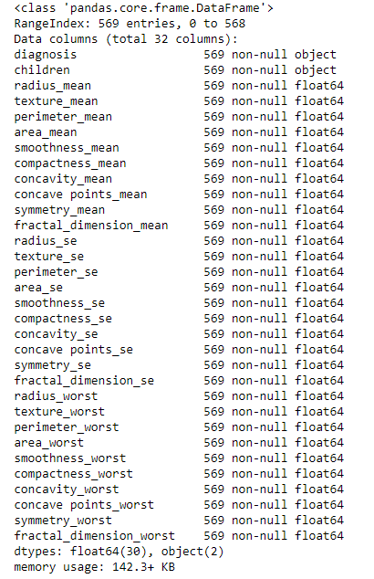
Data
Use these data to predict
the diagnosis

Slide 7
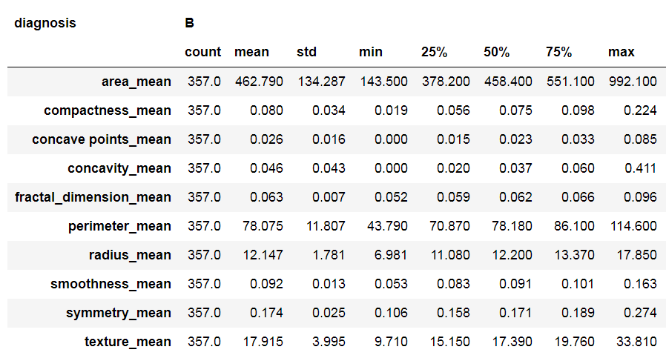
Summary Data
Benign Diagnosis

Slide 8
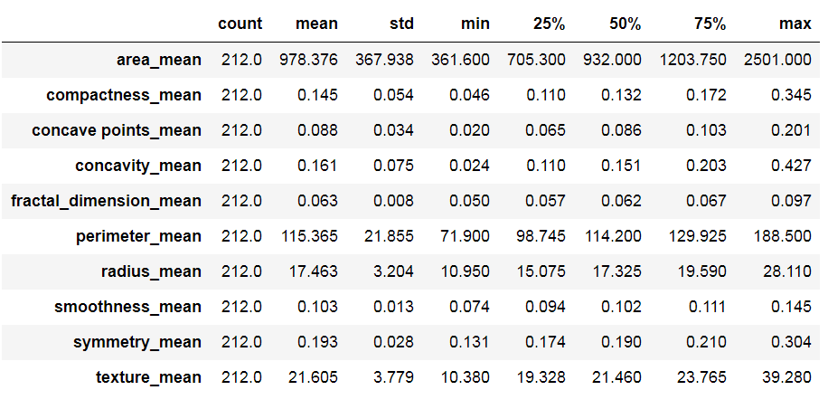
Summary Data
Malignant Diagnosis

Slide 9
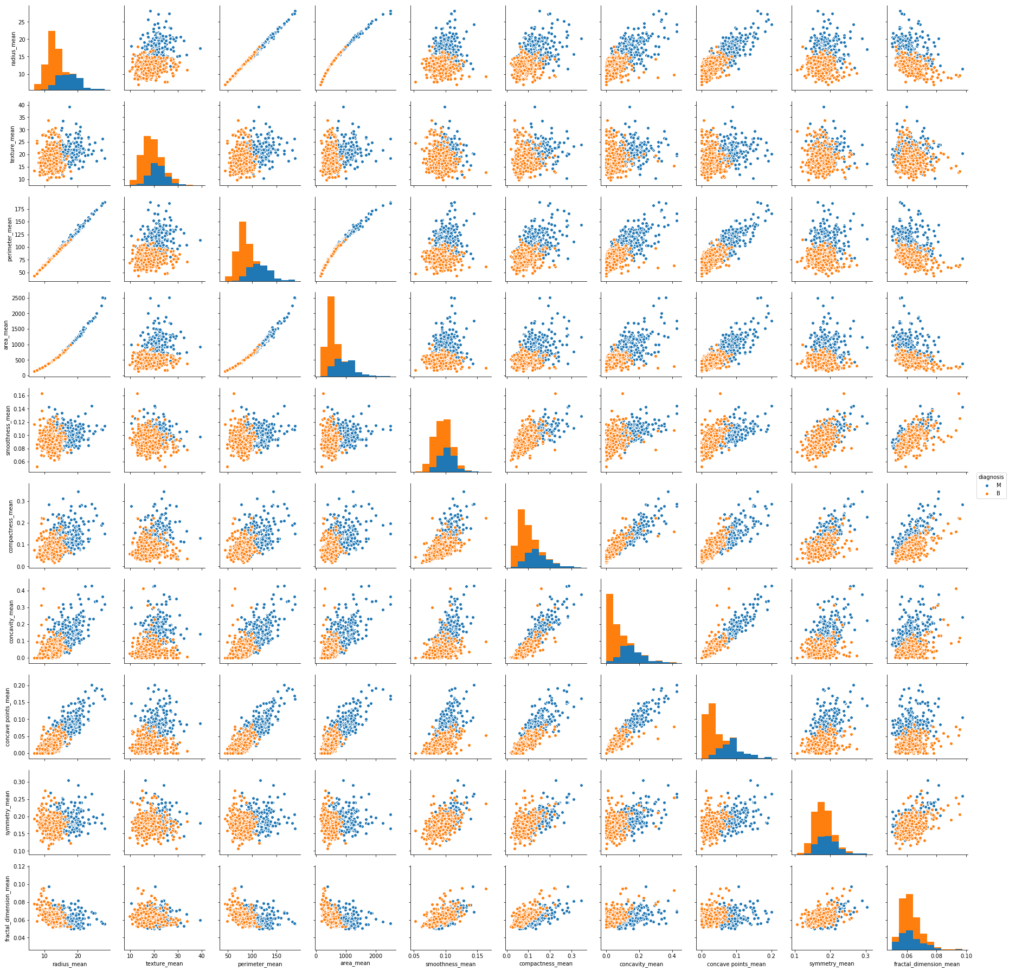
Summary Data

Slide 10
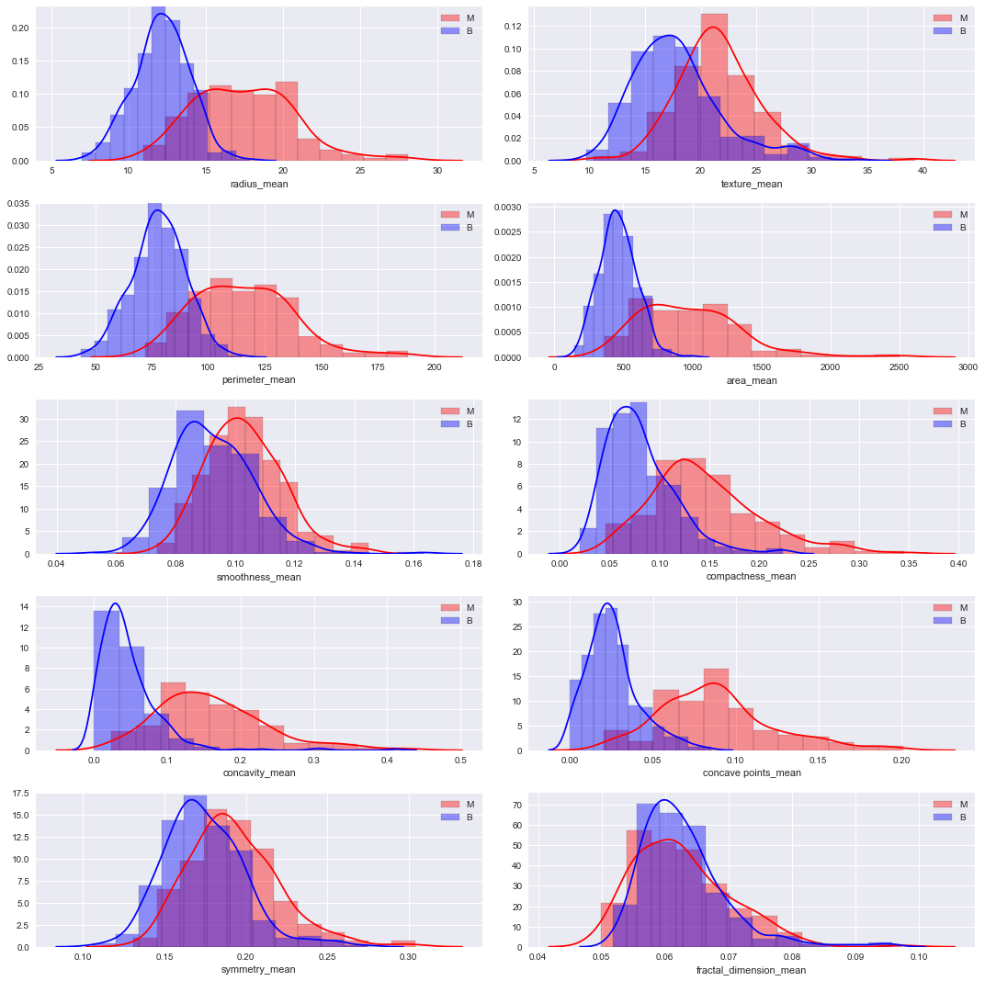

Slide 11
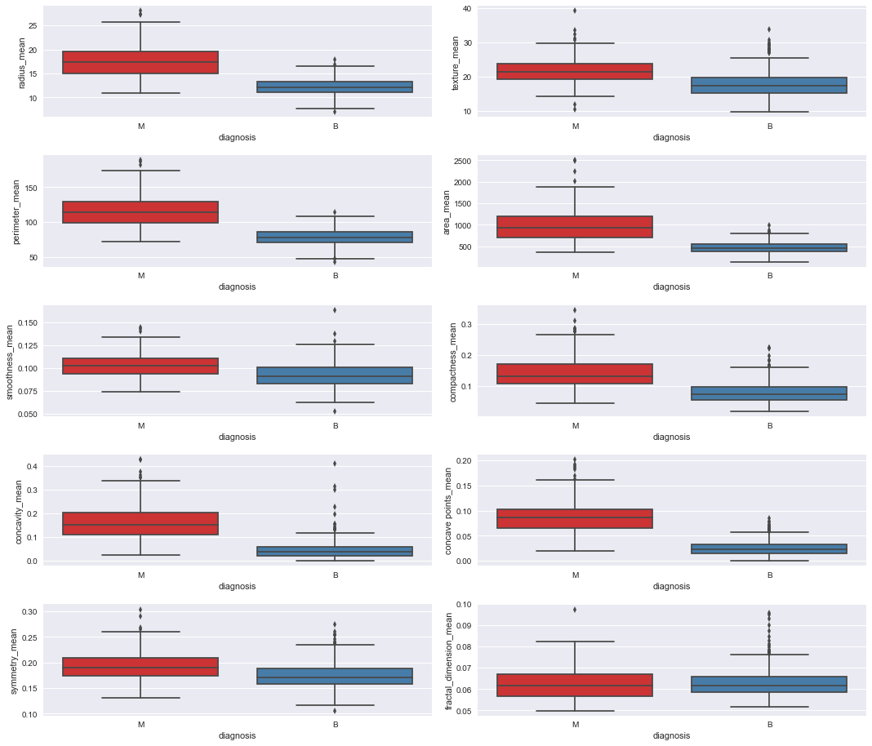

Slide 12
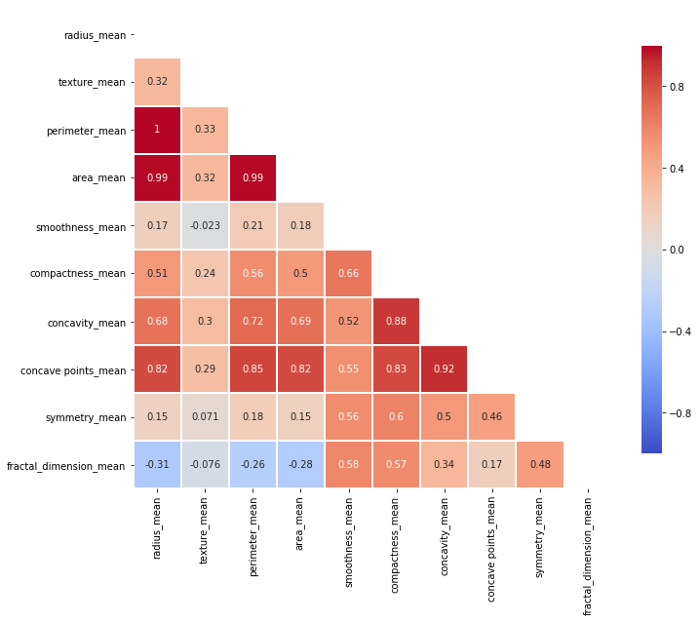
Linear Regression Analysis
Correlation Heat Map

Slide 13
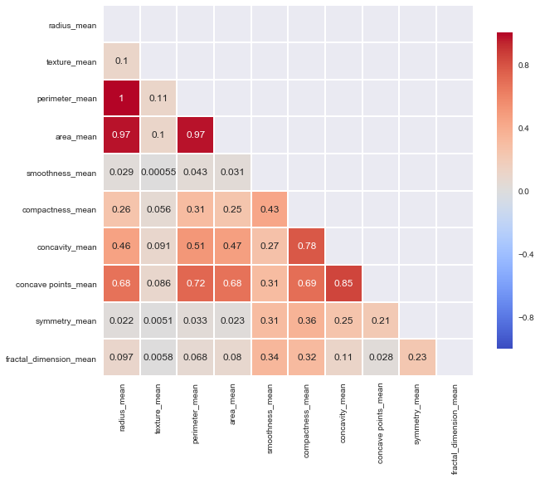
Linear Regression Analysis
R-squared Heat Map

Slide 14
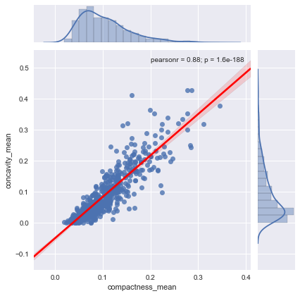
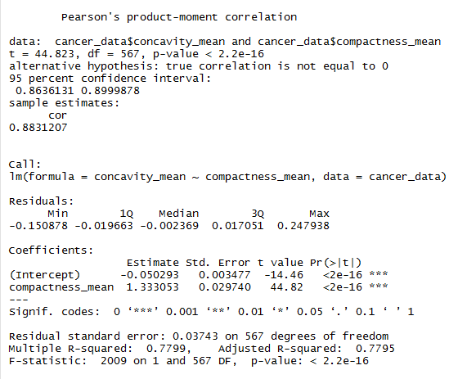
Linear Regression Analysis
Concavity_mean vs. Compactness_mean

Slide 15
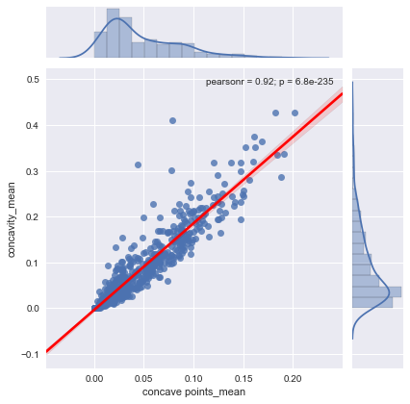
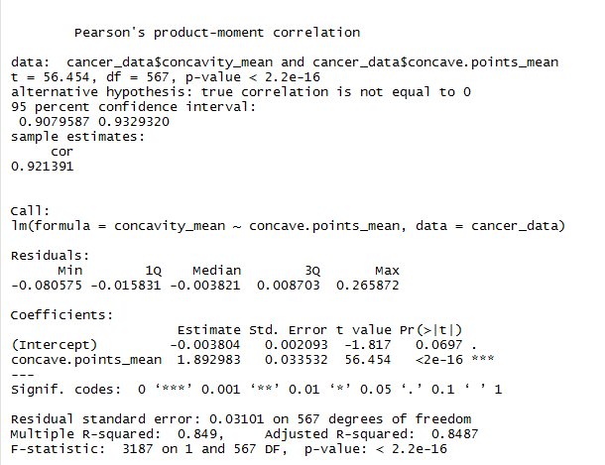
Linear Regression Analysis
Concavity_mean vs. Concave points_mean

Slide 16
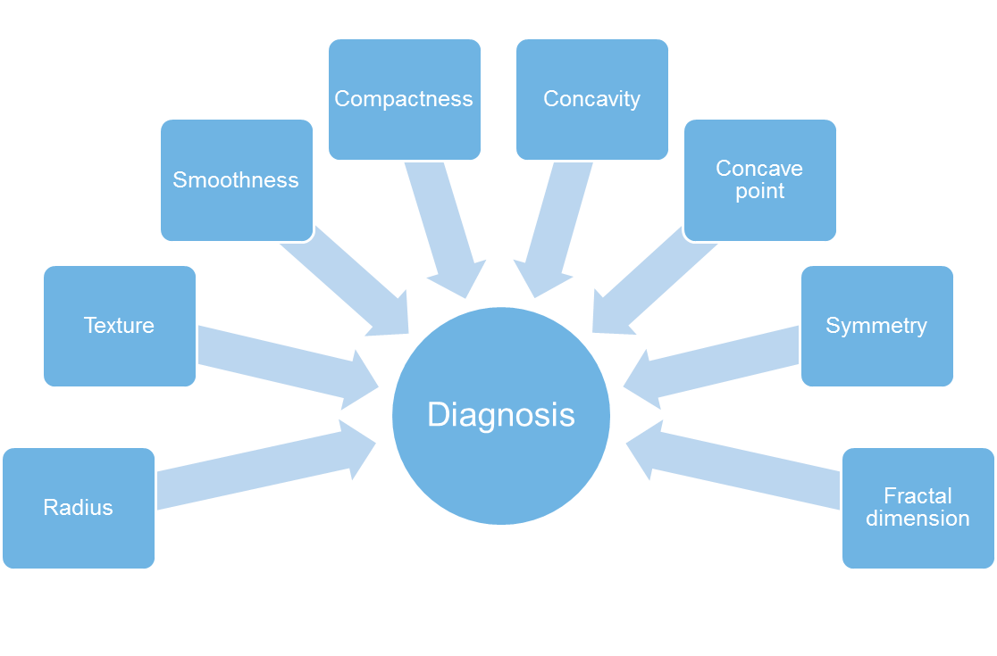
Logistic Regression Analysis

Slide 17
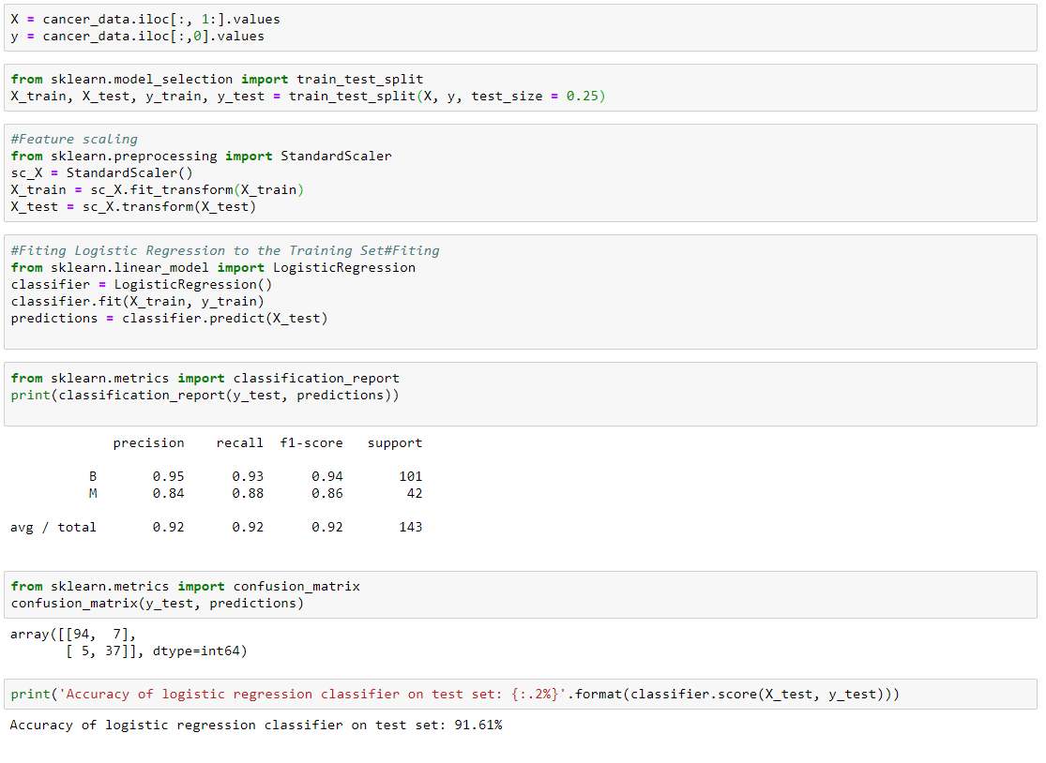
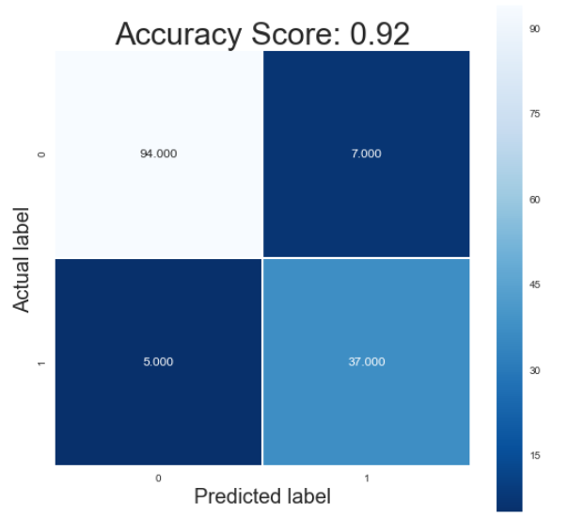
Logistic Regression Analysis

Slide 18
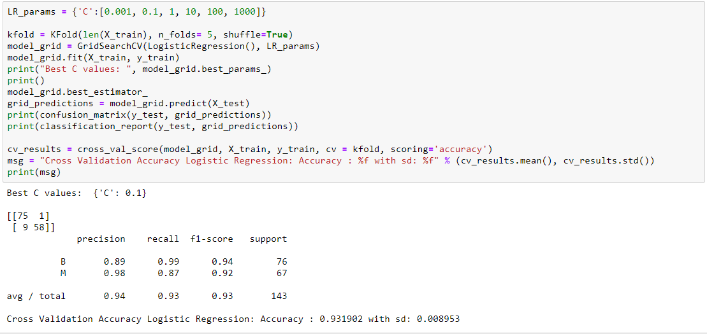
Logistic Regression Optimization

Slide 19
Thank You !
github.com/tamhuynh92/
Edit your company slogan

